Slide 1

School of Computer Science and Engineering (CAT-3 B Tech Sem-II, Fall2021-22)
Course Code: BBS01T1008 Course Name: Biology for Engineers
Topic: X-Ray Computed Tomography
Section-7
ROUNAK KUMAR
PUSHKAR AASHISH
MOHIT KUMAR
SHIVAM DWRIVEDI
Program Name:B.Tech

Slide 2
School of Computer Science and Engineering (CAT-3 B Tech Sem-II, Fall2021-22)
Course Code : BBS01T1008 Course Name: Biology for Engineers
content:
INTRODUCTION
HOW CT SCAN WORKS
WHAT IS THE NEED OF CT SCAN
ADVANTAGES OF CT SCAN
DISADVANTAGES OF CT SCAN
REFERENCE
Program Name:B.Tech

Slide 3
School of Computer Science and Engineering (CAT-3 B Tech Sem-II, Fall2021-22)
Course Code : BBS01T1008 Course Name: Biology for Engineers
What is a computed tomography (CT) scan?
The first commercially viable X-Ray CT scanner was invented by Goldfrey Hounsfield in 1972.
The term “computed tomography”, or CT, refers to a computerized x-ray imaging procedure in which a narrow beam of x-rays is aimed at a patient and quickly rotated around the body, producing signals that are processed by the machine’s computer to generate cross-sectional images—or “slices”—of the body.
These slices are called tomographic images and contain more detailed information than conventional x-rays.
Program Name:B.Tech

Slide 4
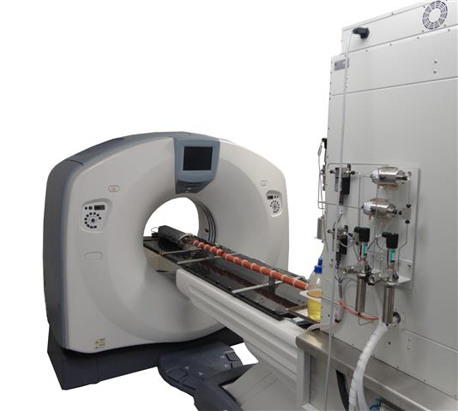
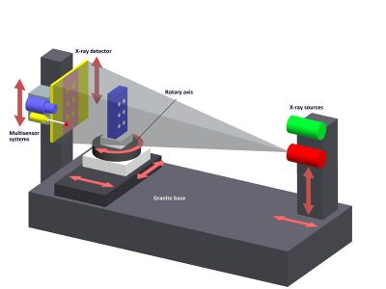
School of Computer Science and Engineering (CAT-3 B Tech Sem-II, Fall2021-22)
Course Code : BBS01T1008 Course Name: Biology for Engineers
Once a number of successive slices are collected by the machine’s computer, they can be digitally “stacked” together to form a three-dimensional image of the patient that allows for easier identification and location of basic structures as well as possible tumors or abnormalities.
Program Name:B.Tech

Slide 5
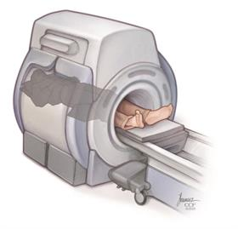
School of Computer Science and Engineering (CAT-3 B Tech Sem-II, Fall2021-22)
Course Code : BBS01T1008 Course Name: Biology for Engineers
How CT Scans Work?
They use a narrow X-ray beam that circles around one part of your body. This provides a series of images from many different angles.
A computer uses this information to create a cross-sectional picture. Like one piece in a loaf of bread, this two-dimensional (2D) scan shows a “slice” of the inside of your body.
This process is repeated to produce a number of slices.
The computer stacks these scans one on top of the other to create a detailed image of your organs, bones, or blood vessels.
Program Name:B.Tech

Slide 6
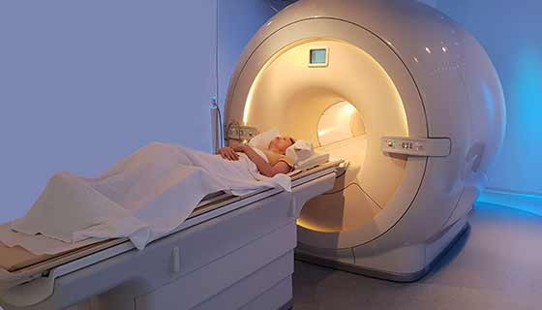
School of Computer Science and Engineering (CAT-3 B Tech Sem-II, Fall2021-22)
Course Code : BBS01T1008 Course Name: Biology for Engineers
WHY WE NEED CT SCAN?
A CT scan has many uses, but it’s particularly well-suited for diagnosing diseases and evaluating injuries.
To diagnose infections, muscle disorders and bone fractures.
Pinpoint the location of tumors.
Assess the extent of internal injuries and
other internal structures.
Guide procedures such as surgeries and
biopsies.
Monitor effectiveness of treatment.
Program Name:B.Tech

Slide 7
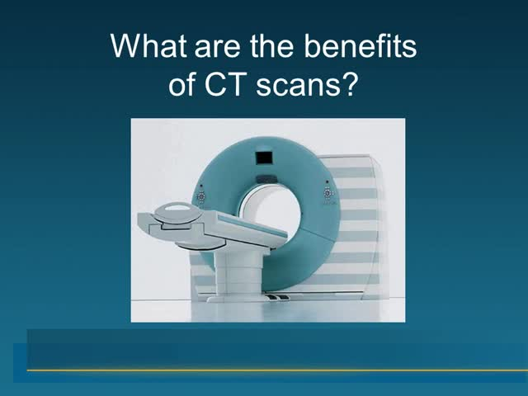
School of Computer Science and Engineering (CAT-3 B Tech Sem-II, Fall2021-22)
Course Code : BBS01T1008 Course Name: Biology for Engineers
ADVANTAGES OF CT SCAN:
CT scanning is painless, non invasive, and accurate.
A major advantage of CT is its ability to image bone, soft tissue, and blood vessels all at the same time.
CT is less sensitive to patient movement than MRI.
Program Name:B.Tech

Slide 8
School of Computer Science and Engineering (CAT-3 B Tech Sem-II, Fall2021-22)
Course Code : BBS01T1008 Course Name: Biology for Engineers
Unlike conventional x-rays, CT scanning provides very detailed images of many types of tissue as well as the lungs, bones, and blood vessels.
CT exams are fast and simple. In emergency cases, they can reveal internal injuries and bleeding quickly enough to help save lives.
CT has been shown to be a cost-effective imaging tool for a wide range of clinical problems.
Unlike MRI, an implanted medical device of any kind will not prevent you from having a CT scan.
Program Name:B.Tech

Slide 9
School of Computer Science and Engineering (CAT-3 B Tech Sem-II, Fall2021-22)
Course Code : BBS01T1008 Course Name: Biology for Engineers
DISADVANTAGES OF CT SCAN:
Requires breath holding which some patients cannot manage.
CT scan increases your risk of cancer and reacting to contrast agents.
The x ray- radiation exposure may make it inappropriate for patients with significant kidney problems.
It cannot be used to assess individual renal function or degree of obstruction.
It is expensive for routine clinical use.
Program Name:B.Tech

Slide 10
School of Computer Science and Engineering (CAT-3 B Tech Sem-II, Fall2021-22)
Course Code : BBS01T1008 Course Name: Biology for Engineers
Risks of CT Scan
CT scans use X-rays, which produce ionizing radiation. Research shows that this kind of radiation may damage your DNA and lead to cancer. But the risk is still very small -- your chances of developing a fatal cancer because of a CT scan are about 1 in 2,000.
But radiation’s effect adds up over your lifetime. So your risk increases with every CT scan you get. Talk to your doctor about the procedure’s potential dangers and benefits, and ask why the CT scan is necessary.
Ionizing radiation may be more harmful in children. That’s because they’re still growing. They also have more years to get exposed to radiation. Before the procedure, you may want to ask the doctor or technician if the CT machine’s settings have been adjusted for a child.
Tell your physician if you’re pregnant. If you need imaging for your stomach area, your doctor may recommend an exam that doesn’t use radiation, such as an ultrasound.
Program Name:B.Tech

Slide 11


